Slide 1
data mining

Slide 2
what why how

Slide 3
by
Stephen Mouring

Slide 4
WHAT

Slide 5
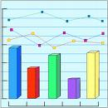

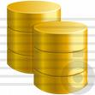
Intersection
Notes:
where these things intersect is where data mining was born.
it is relatively young discipline.
it has become far more relevant in the internet age when the volume of data has increased beyond what humans (or mere statistics) can process.

Slide 6

Focus is on finding relationships
(in large sets of data)
Notes:
statistics is about properties of data
data mining is the next step: relationships within data.
particularly relevant for large sets of data or situations where the data is very complicated (images or video streaming).

Slide 7
web developers:

Slide 8
logic data
Notes:
Our primary job is to write logic and algorithms that solve problems.
For the most part, data is a given to us. We usually do not create it and have limited input on its structure and content. The customer gives it to us and we do stuff with it.
the logic is the interesting part, the data is just a structure for our logic

Slide 9
data miners:

Slide 10
data logic
Notes:
data mining is data centric
it’s a fundamental paradigm shift
the data is the interesting part… our logic is engines that we can run various data sets through to get results. you do little in the way of coding algorithms, as most of the algorithms are well known.
the interesting bit of data mining is how we structure our data (and tune parameters) such that we get good results from the algorithms.

Slide 11
some vocabulary:

Slide 12
features and feature vectors

Slide 13
class label

Slide 15
3 disciplines

Slide 16
Classification

Slide 17
Clustering

Slide 18
Anomaly Detection

Slide 19
WHY

Slide 20
tough problems

Slide 21
automating human functions

Slide 22
HOW

Slide 23
algorithms → models

Slide 24
data → models = answers

Slide 25
two examples:

Slide 26
a quick one

Slide 27
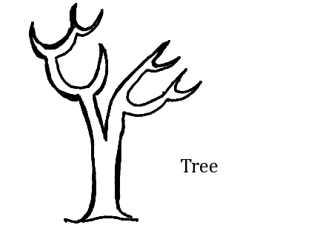
Classifying with
Decision Trees

Slide 28
(note to self: do this on the whiteboard)

Slide 29
Some points to consider:
Classification - FAST
Updating model with new data - HARD
Missing features – HARD (ish)
Requires training set (supervised)

Slide 30
A longer one:

Slide 31
Clustering with
DBScan

Slide 32
basic idea

Slide 33
parameters
distance
number of points

Slide 34


Slide 35
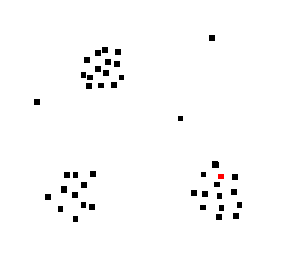

Slide 36
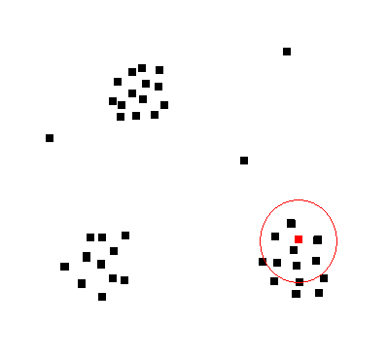

Slide 37
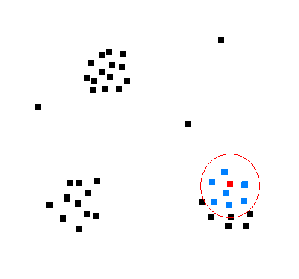

Slide 38
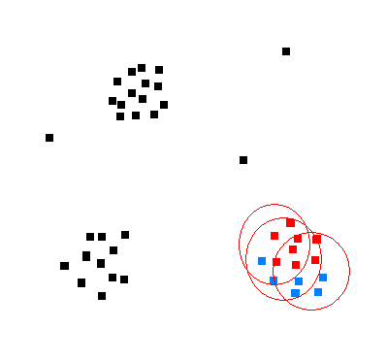

Slide 39
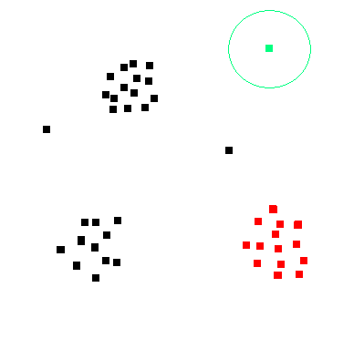

Slide 40


Slide 41
Some points to consider:
Allows outliers
Can handle odd contours
Can handle varying number of clusters

Slide 42
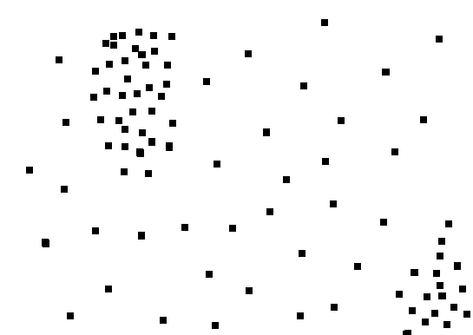

Slide 43


Slide 44
A tool to explore:

Slide 45
WEKA

Slide 46
Some practical examples:

Slide 47
Face recognition

Slide 48
Page detection

Slide 49
Ink spot detection

